Slide 1
ML Deployment using streamlit(Python)

Slide 2


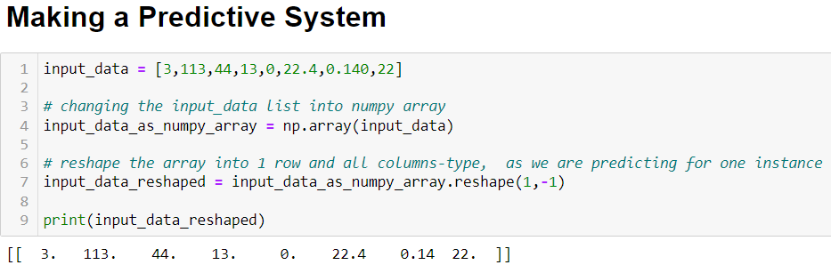
We use Diabetes Dataset and its Project first.
Using best Model…We build the Predictive System

Slide 3
The initial Predictive System code
input_data = (3,113,64,37,225,22.4,0.140,22)
# changing the input_data to numpy array
input_data_as_numpy_array = np.asarray(input_data)
# reshape the array into 1 row and all columns-type, as we are predicting for one instance
input_data_reshaped = input_data_as_numpy_array.reshape(1,-1)
prediction = SVC_classifier.predict(input_data_reshaped)
print(prediction)
if (prediction[0] == 0):
print('The person is not diabetic')
else:
print('The person is diabetic')

Slide 4
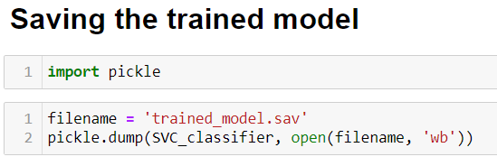
Saving the Trained Model:
We Pickle the trained model to save it in binary form, it takes very less memory. (run “pip install pickle”, to install in python)

Slide 5
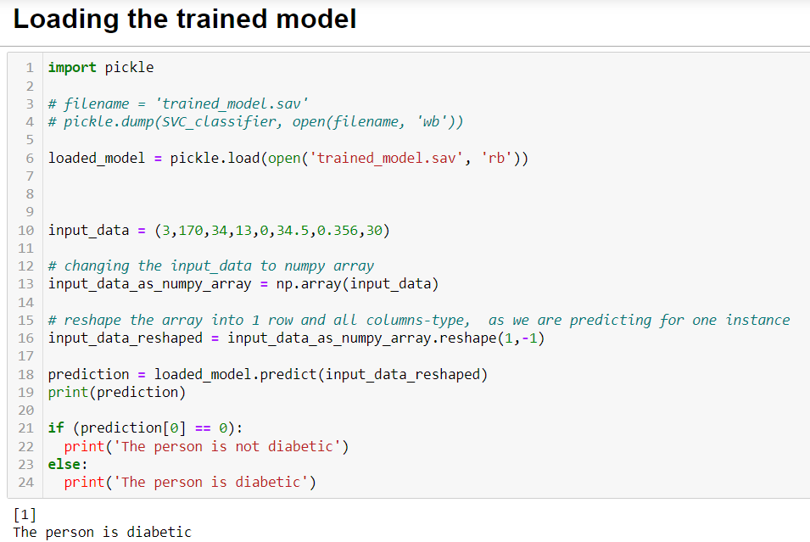
Checking, the working of the trained_model.sav file
Please note: we replaced the classifier with loaded_model this time !

Slide 6
Now:
We need to save this trained_model.sav file in a newly created, ML Deployment Folder.
Then , we create a web app python file with extension “.py”
In this file we import numpy, pickle and streamlit as st
Then, we load our trained_model.sav file , from the above mentioned path of the folder.
After this, we create a def function of the whole prediction system .
Since the code is in the function, therefore we replace the “print” with “return” this time.

Slide 7
Next:
7. We create the Title for our web page.
8. Followed with systematic inputs required and.
9. We create a button to submit and predict the output as per our trained model, through pickle file- “trained_model.sav”.

Slide 8
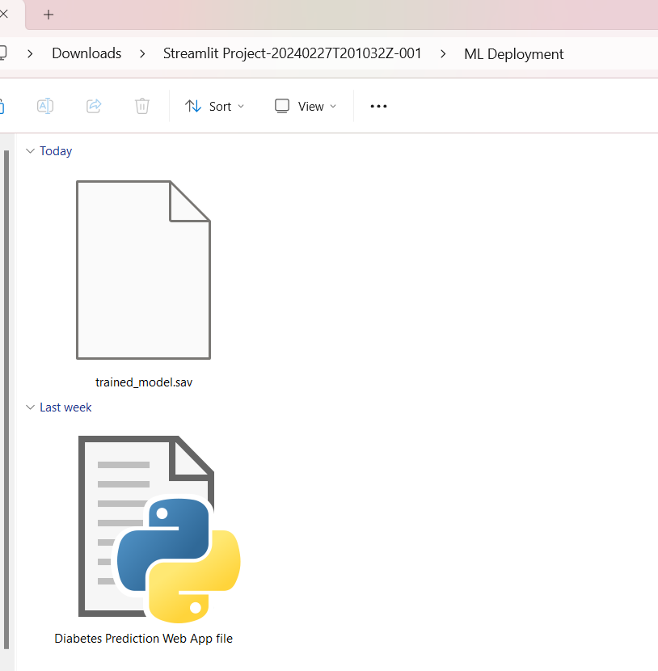
Next: Let us save this file as: Diabetes Prediction Web App file.py…. In the same folder, which we had created.

Slide 9
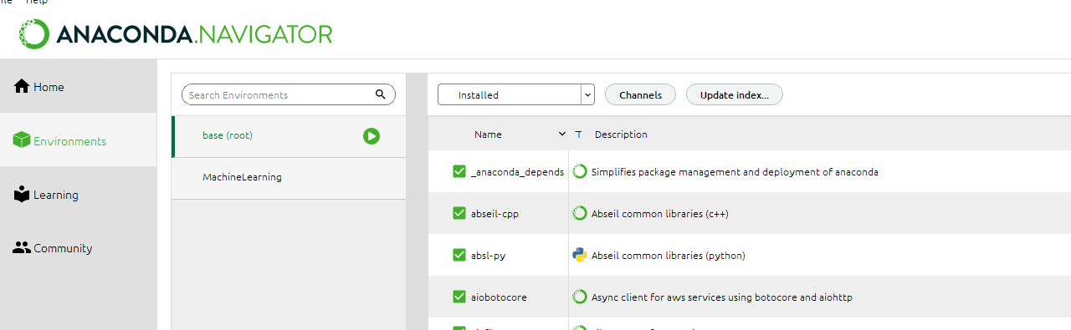
NOW….
We need to create environment for our Project in Anaconda Navigator.

Slide 10
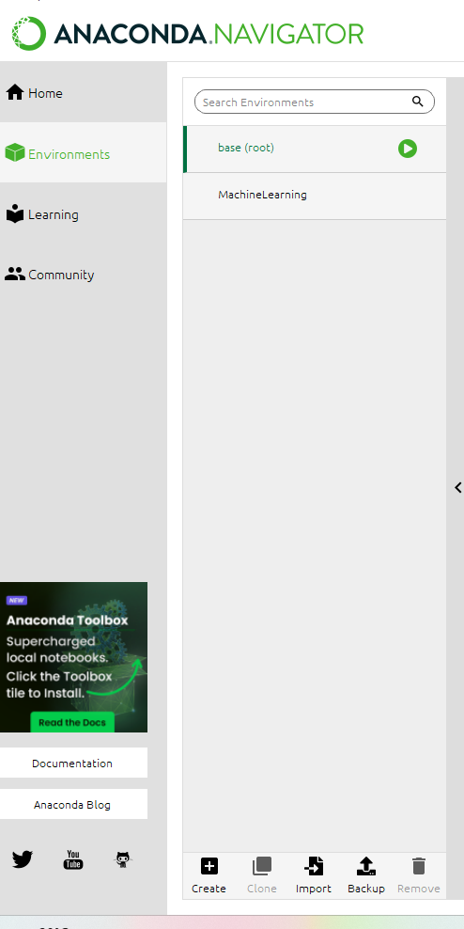

Slide 11
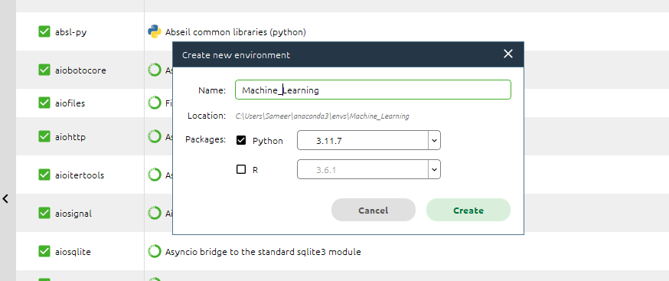

Slide 12
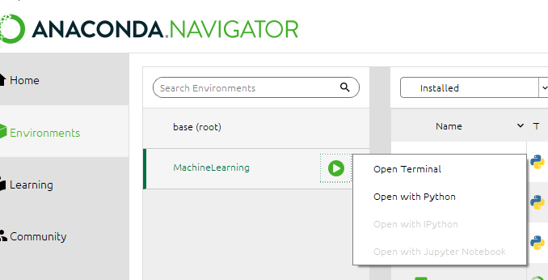
We, need to open Environment, terminal

Slide 13
In the command prompt , We :
pip install pickle-mixin
pip install streamlit
pip install numpy
Pip install scikit-learn
Then, Copy the folders path along with .py filename.
We run the following command:

Slide 14
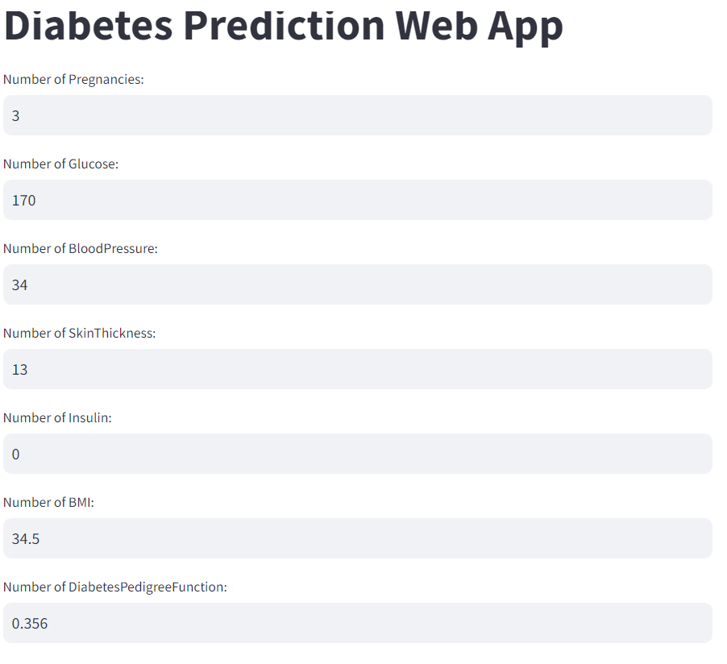
This opens into our web app, ready to take input and Predict accordingly.
This concludes the deployment.

Slide 15
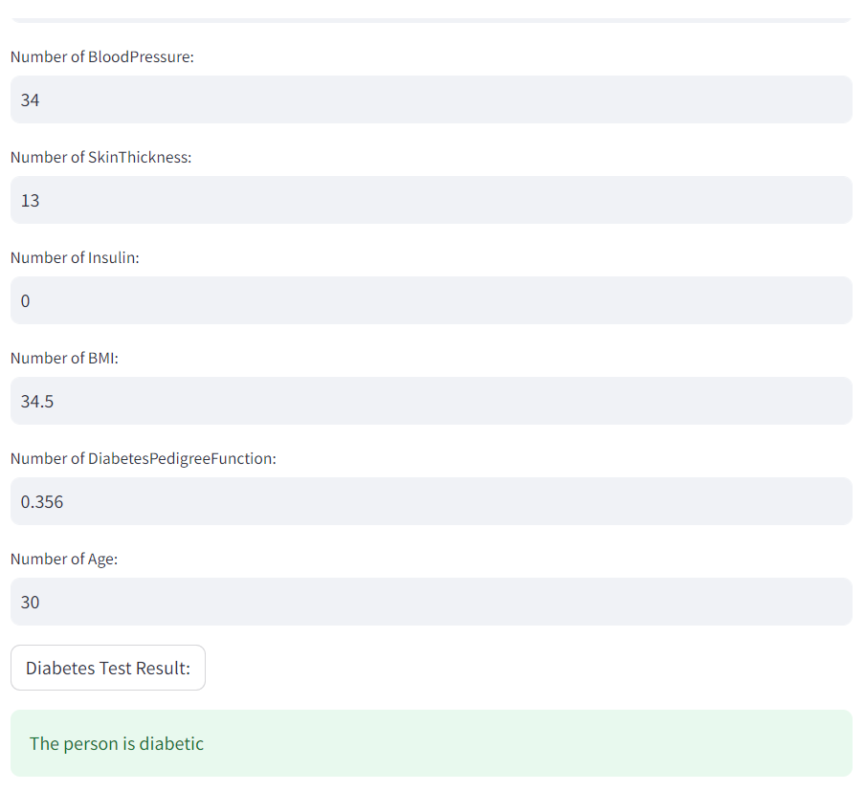

Slide 16
Thank You

